Slide 1

Tenant Income Worksheet
How-To Guide for Completion
Affordable Housing Program (AHP) Rental Occupancy Compliance

Slide 2

Topics
Introduction and Background Details
Helpful Tips Before You Begin
Populating General Project Details
Populating Targeting Details
Populating Tenant Information

Slide 3
Introduction and Background Details

Slide 4

Introduction & Background Details
FHLB Des Moines completes periodic in-depth reviews to validate the AHP rental property is adhering to the household income & rents submitted and approved in the AHP application
The Tenant Income Worksheet (TIW) is a tool utilized during these in-depth reviews
There are two versions of the TIW:
HUD TIW: used by most projects
NAHASDA/MTSP TIW: can only be utilized by Native and/or LIHTC projects

Slide 5
Helpful Tips Before You Begin

Slide 6

Helpful Tips Before You Begin
Do not copy/paste
This can inadvertently corrupt the formulas built into the spreadsheet.
Enter data in the blue cells only
Do not enter transfer information if a tenant transfers from one unit to another
Only initial project entry (or recertification from AHP award) should be entered.

Slide 7
Populating General Project Details

Slide 8
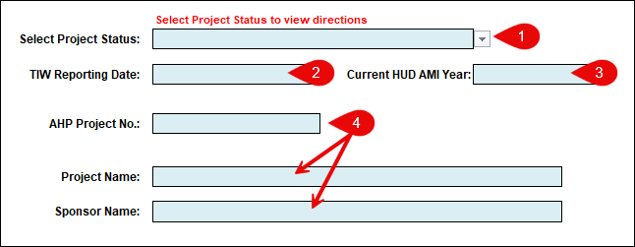
Populating General Project Details
Select Project Status: Project Completion Reporting (PCR) or Long-Term Monitoring (LTM.)
Enter a current TIW Reporting Date
Select Current AMI Year
Enter AHP Project Number, Project Name, Sponsor Name

Slide 9
Populating Targeting Details

Slide 10
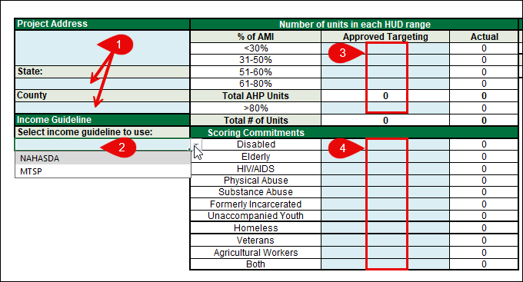
Populating Targeting Details
Enter Project Address and select appropriate State and County from the drop-downs.
If using the NAHASDA-MTSP TIW, select the appropriate income guidelines.
Populate Approved Targeting column as listed in the AHP Agreement
Populate Scoring Commitments column as listed in the AHP application, for Project Completion Reporting (PCR) TIWs only.

Slide 11
Populating Tenant Information

Slide 12
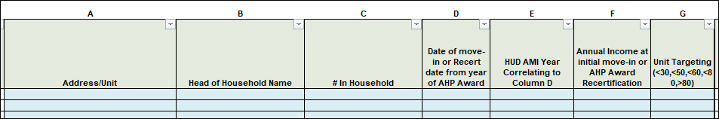
Populating Tenant Information
The Tenant Table must be populated to reflect all tenants living in the project as of your chosen TIW Reporting Date. The following instructions are for the left side of the Tenant Table: columns labeled A-G.
Select Vacant from the drop-down in Column C if the unit is/was vacant as of the TIW Reporting Date.
Reminder: Do not enter transfer information if a tenant transfers from one unit to another.

Slide 13
Populating Tenant Information
The following instructions are for the left side of the Tenant Table: columns labeled A-G.
Occupied Households at AHP Application VS New Household Move-ins
Tenants occupying the project prior to AHP award | New tenants moving into the project after AHP award
Enter recertification information from the year of the AHP Award. *Do not enter most recent recert data. | Enter initial move-in (project entry) information. *Do not enter most recent recert data.
Column C: Enter # of household members at time of AHP Award recertification. | Column C: Enter # of household members at initial move-in.
Column D: Enter date the AHP Award recertification was completed. | Column D: Enter date of initial move-in.
Column F: Enter income determined at the AHP Award recertification. | Column F: Enter income determined at initial move-in.

Slide 14
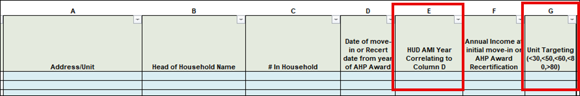
Populating Tenant Information
Column E – AMI Year Correlating to Column D: select the AMI year in effect as of the date entered in Column D.
Column G – Unit Targeting: select the AMI level the household was approved for.

Slide 15
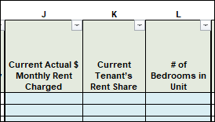
Populating Tenant Information
The following instructions are for the right side of the Tenant Table: columns labeled J-L.
Rent amounts in effect as of your chosen TIW Reporting Date must be entered in these columns. Do not enter rent amounts from time of move-in or from the AHP award recertification.
Column J - Current Actual $ Monthly Rent Charged: the total amount of rent charged for the unit.
Column K - Current Tenant’s Rent Share: the rent amount being paid by the tenant. This amount may be lower than the amount entered in Column J if a rental subsidy is received, and the tenant is not responsible for paying the full rent amount.

Slide 16
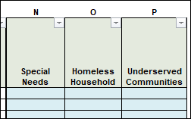

Populating Tenant Information
The following instructions are for the right side of the Tenant Table: columns labeled N-P. *This is not applicable for Long-Term Monitoring (LTM) TIW Reviews. These columns will only appear if you are completing the TIW for a Project Completion Reporting Review (PCR.)
Column N - Special Needs: Enter the applicable Special Needs code for the household (see below.) Only one code can be entered for each household, even though the household may qualify for more than one.
Column O - Homeless Household: Enter Y if the household met the FHLB Des Moines Homeless definition at move-in.
Column P - Underserved Communities: Enter the following codes if the unit is occupied by a V - veteran(s), A - agricultural worker(s), or B – both.
Special Needs Codes:

Slide 17


Questions: Community Investment Department communityinvestment@fhlbdm.com 800.544.3452 ext. 2400

